Slide 1
Diffusion-based Image Generation with Guided Text Prompts and Fine-tuned CLIP Models
CSYE 7380 - Theory & Prac App AI Gen Model
SHIVA TEJA DASI - 002899604

Slide 2
Architecture Overview
Dataset used to fine tune CLIP: Flickr 8k : 8,000 images with 5 human-annotated captions per image, resized to 256x256 pixels for training.
Goal: Fine-tune CLIP to improve image-text alignment, enabling better image understanding from textual descriptions.
Key components:
CLIP Text Encoder: Converts prompts to embeddings for UNet conditioning.
UNet (Stable Diffusion): Iteratively denoises latent representations.
VAE (Variational Autoencoder): Decodes latents into high-resolution images.

Slide 3
Workflow
Data Preprocessing: Images resized to 256x256 pixels, and captions tokenized using the CLIP tokenizer.
Fine-Tuning CLIP: Fine-tuned the CLIP text encoder using contrasting loss to align text and image embeddings.
Training Setup: Used gradient accumulation and mixed precision for efficient memory usage and batch processing.
Inference: Text prompts encoded into embeddings, which guide the Stable Diffusion model to generate images.
Post-processing: Generated images saved with filenames based on the text prompt used for each generation.

Slide 4
Diffusion Model
Forward Process: Adds noise step-by-step to reach pure noise.
Reverse Process: Learns to denoise step-by-step to reconstruct images.
Classifier-Free Guidance: Combines conditional and unconditional predictions to align output with prompts.

Slide 5
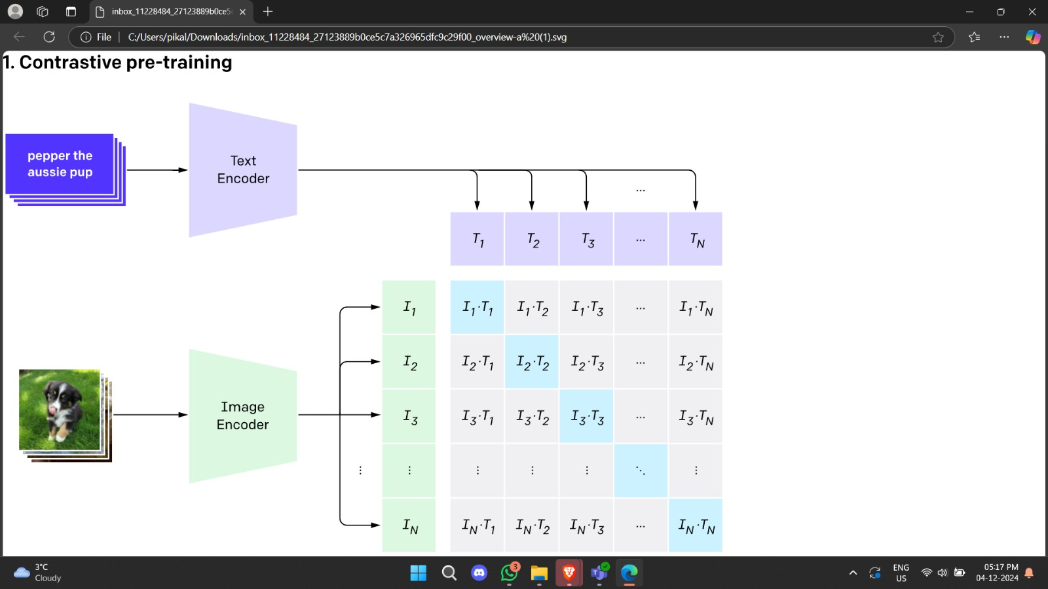
Contrastive Loss (CLIP)
Aligns text and image embeddings in a shared space.
Positive Pairs: Bring correct text-image pairs closer.
Negative Pairs: Push incorrect pairs apart.
Loss: Maximizes similarity for matching pairs, minimizes for mismatches.

Slide 6
Precision and Optimization
Mixed Precision: Combines float16 and float32 to reduce memory usage and increase speed.
Attention Slicing: Processes attention in smaller chunks for efficiency.
Efficient Scheduling: Scales noise dynamically for better convergence.

Slide 7
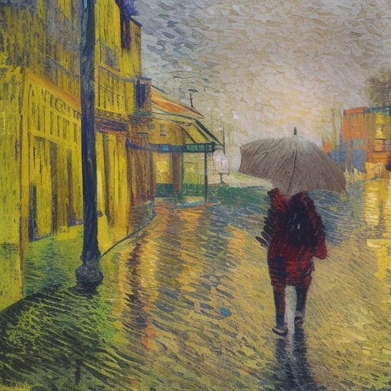
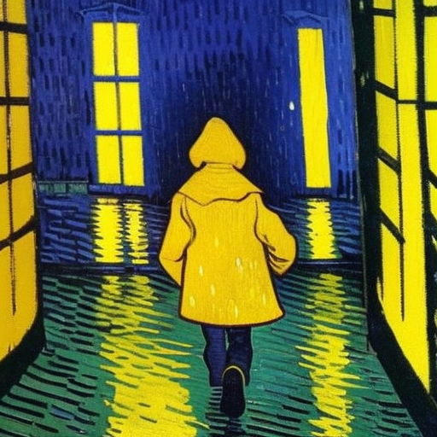
Results
Results for prompt: A child wearing a yellow coat walking in rain, in a vincent van gogh style
With a guiding scale of 2.0 2. With a guiding scale of 10.0

Slide 8
Thank you

